Slide 1
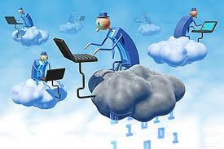
CLOUD COMPUTING
I

Slide 2
Introduction to Cloud Computing
The US National Institute of Standards and Technology (NIST) defines the cloud as –
  Cloud computing is a model for enabling ubiquitous, convenient, on-demand network access to a shared pool of configurable computing resources (e.g., networks, servers, storage, applications, and services) that can be rapidly provisioned and released with minimal management effort or service provider interaction.

Slide 3
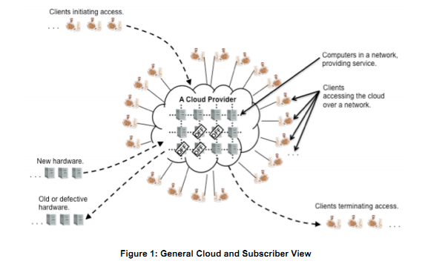
Cloud

Slide 4
Introduction to Cloud Computing
cloud computing is simply a means of delivering IT resources as services.
Almost all IT resources can be delivered as a cloud service: applications, compute power, storage capacity, networking, programming tools, even communications services and collaboration tools.
Cloud computing began as large-scale Internet service providers such as Google, Amazon, and others built out their infrastructure.

Slide 5
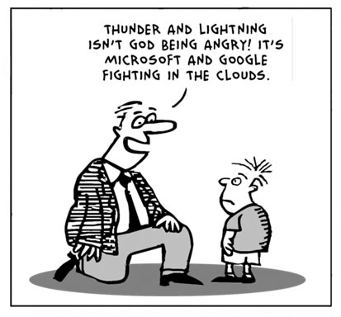

Slide 6
Introduction to Cloud Computing
It allows applications and services to run on a distributed network using virtualized resources.
Also allows these to be accessed by common internet protocols and networking standards.
End-user is not required to know the physical location and configuration of the system that delivers the services.

Slide 7
Introduction to Cloud Computing
It delivers higher efficiency, massive scalability, and faster, easier software development.
It’s about new programming models, new IT infrastructure, and the enabling of new business models.
more efficient large-scale cloud deployments that can provide the infrastructure for next-generation business opportunities: social networks, algorithmic trading, continuous risk analysis, and so on.

Slide 8
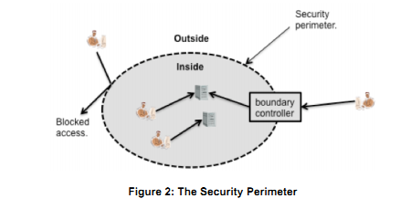
Boundary of a Cloud

Slide 9
CLOUD COMPUTING BASICS

Slide 10
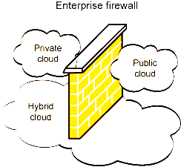
CLOUD Types

Slide 11
Cloud Types
NIST has a set of working definitions that separate cloud computing into two types of models.
Deployment model
  Based on the location of the cloud and its purpose
Service model
  Based on the tye of service provided by the cloud.

Slide 12
Cloud Types
Deployment models.
Private cloud.
  an organization’s own cloud.
  It may be managed by the organization or a third party
  may exist on premise or off premise.
Private clouds are a good option for companies dealing with data protection and service-level issues.
Private clouds are on-demand infrastructure owned by a single customer who controls which applications run, and where.
They own the server, network, and disk and can decide which users are allowed to use the infrastructure.

Slide 13
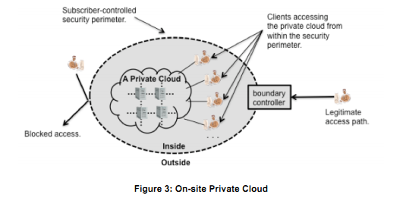
Private Cloud

Slide 14
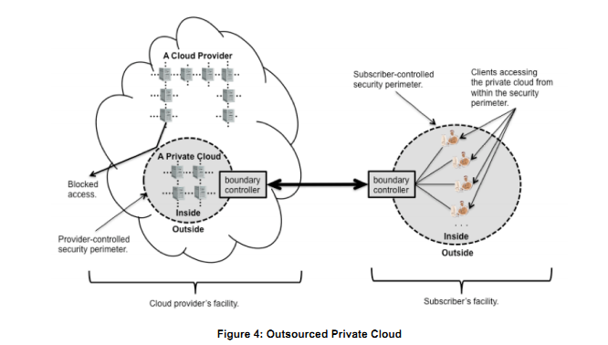
Outsourced Private Cloud

Slide 15
Cloud Types
Deployment models.
Community cloud
  The cloud infrastructure is shared by several organizations and supports a specific community.
  It may be managed by the organizations or a third party
  may exist on premise or off premise.

Slide 16
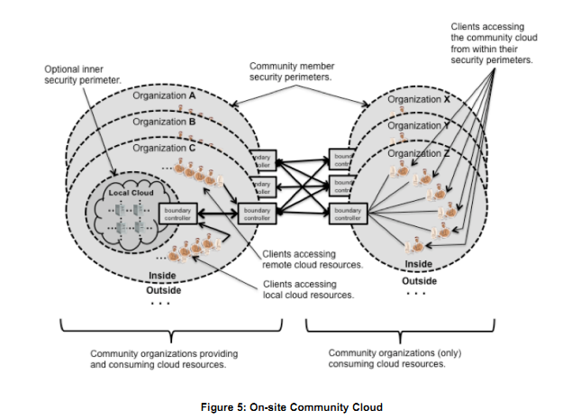
On-Site Community Cloud

Slide 17
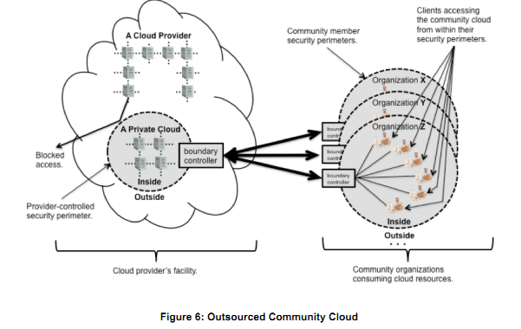
Out Sourced Community Cloud

Slide 18
Cloud Types
Deployment models.
Public cloud.
  The cloud infrastructure is made available to the general public
  May be used by large industry group
  Generally owned by an organization selling cloud services.
Public clouds are run by third parties, and jobs from many different customers may be mixed together on the servers, storage systems, and other infrastructure within the cloud.
End users don’t know who else’s job may be running on the same server, network, or disk as their own jobs.

Slide 19
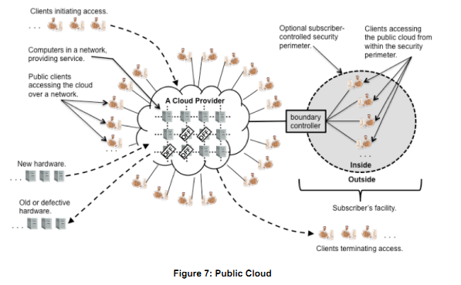
Public Cloud

Slide 20
Cloud Types
Deployment models.
Hybrid cloud
  The cloud infrastructure is a composition of two or more clouds (private, community, or public)
  bound together by standardized or proprietary technology that enables data and application portability (e.g., cloud bursting for load-balancing between clouds).

Slide 21
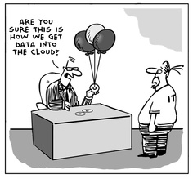

Slide 22
Cloud Types
Service models.
Software as a Service (SaaS).
SaaS is at the highest layer and features a complete application offered as a service, on-demand, via multi-tenancy ,meaning a single instance of the software runs on the provider’s infrastructure and serves multiple client organizations.

Slide 23
Cloud Types
Service models.
Software as Service (SaaS).
  The service provided to the consumer is to use the provider’s applications running on a cloud infrastructure.
  The applications are accessible from various client devices
  Generally a thin client interface such as a Web browser is provided.
  The consumer does not manage or control the underlying cloud infrastructure including network, servers, operating systems, storage, or even individual application capabilities,
  exception of limited user-specific application configuration settings.

Slide 24
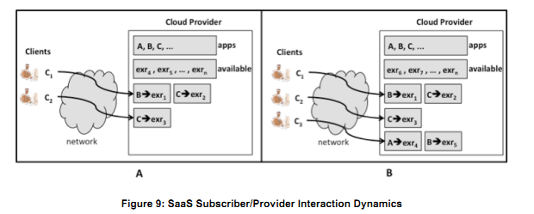
Software as a Service

Slide 25
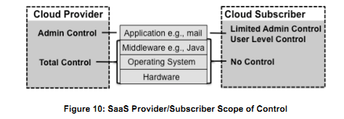
Scope of Control

Slide 26
Cloud Providers
SaaS –
  Google Apps
  Microsoft Office 365
  Zoho office
  SalesForce.com
  SQL Azure
  Oracle on Demand

Slide 27
Software as a Service
LiveOps
  LiveOps Contact Center Application Suite, which integrates call-center functions such as chat and e-mail, inbound call routing, interactive voice response and workforce management
  http://www.liveops.com/
Knowledge Tree
  KnowledgeTree enables traditional document management and collaboration features, including document versioning and auditing, metadata and content searching, workflow, tagging and tag clouds, RSS feeds and e-mail triggers. Useful for sales teams.
  https://www.knowledgetree.com/

Slide 28
Software as a service
Taleo
  Taleo operates the Talent Management Cloud, which it says comprises scalable, elastic and secure infrastructure; an open, mobile and flexible software platform and a full suite of talent management applications.
  These include recruiting, performance management, compensation management, employee development and succession planning.
  Taleo Website

Slide 29
Software as a Service
Project Management Software Providers
Project managers have a number of cloud-based options to manage projects, which can help streamline their tasks and improve collaboration.
  MS Project
  Clarizen
  GroupCamp
  Planzone
  Zoho Projects.

Slide 30
Software as a Service
Help Desk Software Providers
SaaS help desk solutions can streamline support administration, reduce infrastructure costs, and improve the way you communicate with your internal and external customers by extending support to different types of users.
  itBit
  FreshDesk
  ZenDesk
  Desk.com

Slide 31
Software as a Service
PIXLR
It is a cloud based collection of photo editing tools.
Pixlr was founded in Sweden in 2008 by Ola Sevandersson. On 19 July 2011, the suite was acquired by Autodesk.
https://pixlr.com/

Slide 32
Software as a Service
QuickBooks
QuickBooks is a very simple and easy to use online accounting software which helps you manage business finances in just a click
http://www.quickbooks.in/features/
BlueJeans Network
It is a company that provides cloud-based video communications service.
Every BlueJeans member is provided with a private “meeting room” in the BlueJeans cloud to schedule and host conference meetings. It brings together business conferencing solutions like Cisco, Microsoft Lync, Lifesize, and Polycom with consumer services like Google.

Slide 33
Cloud Types
Service models.
Platform as Service (PaaS).
  Consumer uses cloud to deploy his applications.
  Applications can be consumer-created or acquired.
  applications created using programming languages and tools supported by the provider.
  The consumer does not manage or control the underlying cloud infrastructure
  Has control over the deployed applications and possibly application hosting environment configurations.

Slide 34
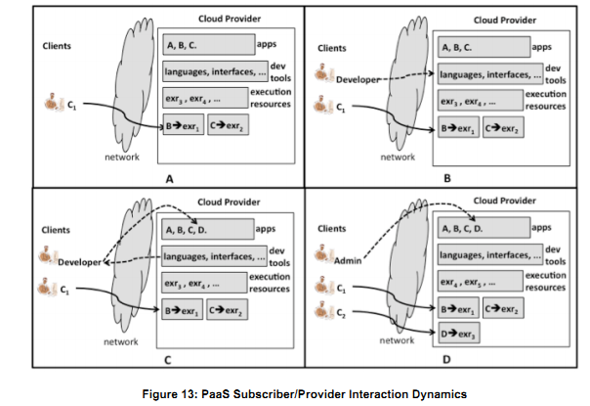
Platform as a Service

Slide 35
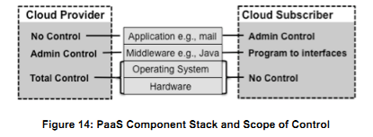
Scope of Control

Slide 36
Cloud Providers
PaaS –
  Google AppsEngine
  Microsoft Azure
  Force.com
  GoGrid CloudCenter
  Amazone Web Services
  Long Jump
  IBM Smart Cloud

Slide 37
Platform as a Service
Engine Yard
  Engine Yard is designed for web application developers using Ruby on Rails, PHP and Node.js who want to take advantage of cloud computing without the operations management responsibility.
  Engine Yard provides a set of services on top of Amazon AWS.

Slide 38
Platform as a Service
Red Hat OpenShift
  Red Hat OpenShift is based on open source applications and offers a wide variety of languages, databases and components.
  The PaaS is highly customizable and offered in three forms: OpenShift Online (a cloud-based hosting service), OpenShift Enterprise (a private PaaS that runs in your data center) and OpenShift Origin (the open source application hosting platform).
  OpenShift automates system administration tasks such as virtual server provisioning, configuration and scaling and supports git repositories for code management.

Slide 39
Platform as a Service
APPFOG
  AppFog is a multi-language, multi-framework PaaS that's a good option for multi-cloud deployments, including private clouds.
  AppFog supports Java, Ruby, PHP, Python, Node, Scala and Erlang and offers MySQL, PostgreSQL, Redis and RabbitMQ along with third party add-on services.
  It can be used as a Database as a Service with ClearDB, MongoHQ, MongoLab, Redis Cloud and Xeround.

Slide 40
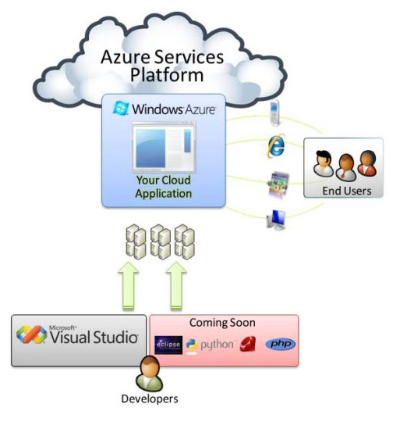

Slide 41
Cloud Types
Service models.
Infrastructure as Service (IaaS).
  The processing, storage, networks, and other fundamental computing resources are provided by the cloud to the consumer.
  the consumer is able to deploy and run arbitrary software, which can include operating systems and applications.
  The consumer does not manage or control the underlying cloud infrastructure but has control over operating systems, storage, deployed applications, and possibly limited control of select networking components (e.g., host firewalls).

Slide 42
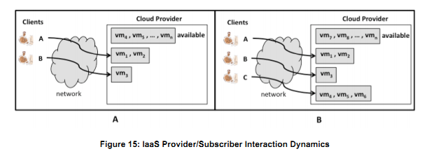
Infrastructure as a Service

Slide 43
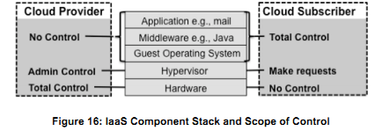
Scope of Control

Slide 44
Cloud Providers
IaaS –
  Eucalyptus
  Windows Azure
  GoGrid
  Rackspace Cloud
  Desktone
  CloudSigma

Slide 45
Infrastructure as a Service
Amazon Web Services
  Amazon Web Services offers a full range of compute and storage offerings, including on-demand instances and specialized services such as Amazon Elastic Map Reduce (EMR) and Cluster GPU instances, as well as Elastic Block Storage (EBS) and high performance SSDs on the storage side.
  Additionally, the IaaS offers infrastructure services such as workflows, message passing, archival storage, in-memory caching services, search services, both relational and NoSQL databases and more.

Slide 46
Infrastructure as a service
IBM Smart Cloud Enterprise
  The IaaS is ideal for enterprises managing a large number of developers and testers who need to deploy virtual machines and allocate storage as efficiently as possible.
  You can manage administrator and user roles, set limits on resources users can deploy and readily report on user activity.

Slide 47
Infrastructure as a Service
HP Enterprise Converged Infrastructure
  HP's cloud is built on OpenStack and its IaaS service is part of the company's Converged Cloud Solutions for public, hybrid and private clouds.
  HP offers Windows and Linux command line interfaces in addition to the dashboard as well as a RESTful API so you can use cURL for low level access to HP's cloud functions.
  HP cloud also offers simple access to its content distribution network (CDN), particularly useful for companies with a global customer and/or user base.

Slide 48
Cloud -Essential Characteristics

Slide 49
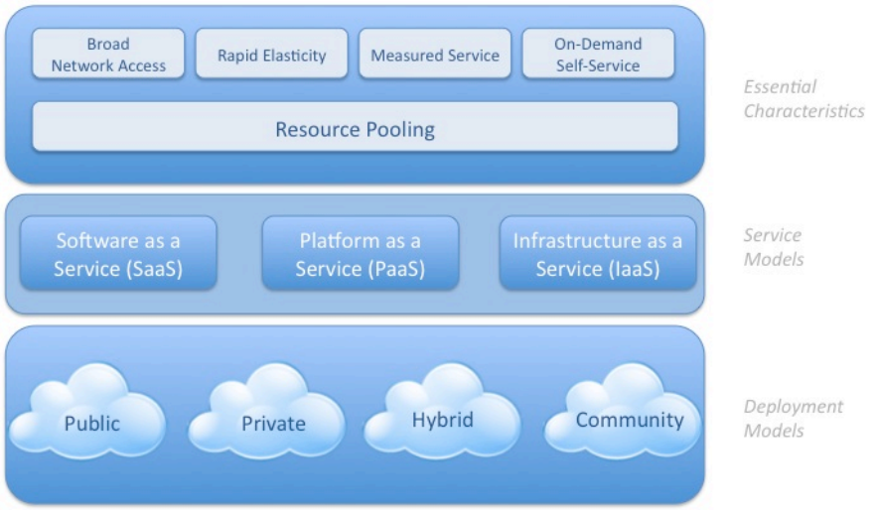


Slide 50
Essential Characteristics
On-demand self-service.
  A consumer should receive computing capabilities, such as server time and network storage, as needed automatically without requiring human interaction with each service’s provider.
Broad network access.
  services are available over the network and accessed through standard mechanisms
  Support for use of heterogeneous thin or thick client platforms (e.g., mobile phones, laptops, and personal digital assistants (PDAs)).

Slide 51
Essential Characteristics
Resource pooling.
  Support for computing resources pooling to serve multiple consumers using a multi-tenant model
  different physical and virtual resources should be dynamically assigned and reassigned according to consumer demand.
  There is a sense of location independence in that the subscriber generally has no control or knowledge over the exact location of the provided resources but may be able to specify location at a higher level of abstraction (e.g., country, state, or datacenter).

Slide 52
Essential Characteristics
Rapid elasticity.
  Services or resources can be rapidly and elastically provisioned, in some cases automatically, to quickly scale out and rapidly released to quickly scale in.
  To the consumer, the capabilities available for provisioning often appear to be unlimited and can be purchased in any quantity at any time.

Slide 53
Essential Characteristics
Measured Service.
  Cloud systems automatically control and optimize resource use by leveraging a metering capability at some level of abstraction appropriate to the type of service (e.g., storage, processing, bandwidth, and active user accounts).
  Resource usage can be monitored, controlled, and reported providing transparency for both the provider and consumer of the utilized service.

Slide 54
Essential Characteristics
Data in the cloud — More than just compute utilities, cloud computing is increasingly about petascale data.
Open Storage products offer hybrid data servers with unprecedented efficiency and performance for the emerging data-intensive computing applications that will become a key part of the cloud.

Slide 55
Essential Characteristics
Interoperability — While most current clouds offer closed platforms and vendor lock-in, developers clamor for interoperability.
Open-source product strategy and Java™ principles are focused on providing interoperability.
Think of the existing cloud “islands” merging into a new, interoperable “Intercloud” where applications can be moved to and operate across multiple platforms.

Slide 56
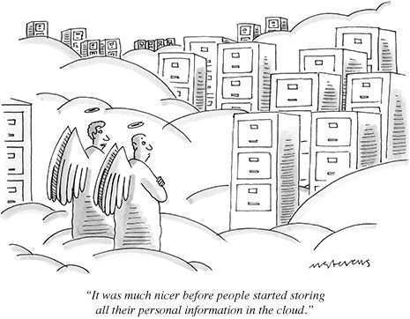

Slide 57
CLOUD CUBE MODEL

Slide 58
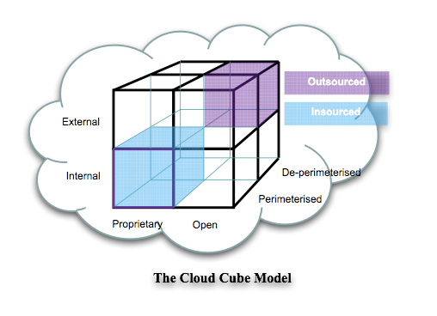
Jericho’s Cloud Cube Model

Slide 59
Jericho’s Cube Model
Jericho Forum is the leading international IT security thought-leadership association dedicated to advancing secure business in a global open-network environment.
Members include top IT security officers from multi-national Fortune 500s & entrepreneurial user companies, major security vendors, government, & academics.
Working together, members drive approaches and standards for a secure, collaborative online business world.

Slide 60
Jericho’s Cube Model
A model for evaluating and determining if and where cloud-based computing makes sense for an organization.
The Jericho Forum’s so-called Cloud Cube Model white paper , which provides best practices and criteria for going to the cloud, as well as choosing the appropriate service providers.
The Jericho Forum cloud cube computing model is designed to be an essential first tool to help business evaluate the risk and opportunity associated with moving into the cloud.

Slide 61
Jericho’s Cube Model
The four dimensions of the cloud cube model are-
Physical Location of the data
  Internal / External decide an organizations boundaries.
Ownership
  Proprietary / Open decides the cost of technology ownership, interoperability
Security Boundary
  Perimererised / De-perimeterised decides wether operation is inside or outside of the network firewall
Sourcing
  Insourced / Outsourced decides if the service is provided by the self staff or service provider.

Slide 62
Cloud Benefits

Slide 63
Benefits of Cloud Computing
IT Efficiency — Minimize costs where companies are converting their IT costs from capital expenses to operating expenses through technologies such as virtualization.
Cloud computing begins as a way to improve infrastructure resource deployment and utilization, but fully exploiting this infrastructure eventually leads to a new application development model.

Slide 64
Netflix, is taking advantage of cloud resources as it meets up and down demand for its Internet subscription service for movies and TV shows.
“Because it streams many movies and shows on demand, the company faces large surges of capacity at peak times,” the report explains. “

Slide 65
As Netflix began to outgrow its data center capabilities, the company made a decision to migrate its Website and streaming service from a traditional data center implementation to a cloud environment.
This move allowed the company to grow and expand its customer base without having to build and support a data center footprint to meet its growth requirements.”

Slide 66
Cloud Success Stories
In 2013, Novartis ran a project that involved virtually screening 10 million compounds against a common cancer target in less than a week. They calculated that it would take 50,000 cores and close to a $40 million investment if they wanted to run the experiment internally. Partnering with Cycle Computing and Amazon Web Services (AWS), Novartis built a platform leveraging Amazon Simple Storage Service (Amazon S3), Amazon Elastic Block Store (Amazon EBS), and four Availability Zones. The project ran across 10,600 Spot Instances (approximately 87,000 compute cores) and allowed Novartis to conduct 39 years of computational chemistry in 9 hours for a cost of $4,232. Out of the 10 million compounds screened, three were successfully identified.

Slide 67
Cloud Success Stories
Pinterest is no stranger to rapid growth, expanding from 50,000 users to 17 million in 9 months. Now at 48 million users, Pinterest was able to scale its business because it was built on Amazon Web Services (AWS). With a company of fewer than 12 employees, Pinterest didn’t want to dedicate staff time to managing a data center. Instead, Pinterest uses AWS to manage a high-performance social application that stores more than 8 billion objects and 400 terabytes of data in the AWS Cloud using Amazon Simple Storage Service (Amazon S3), and 225,000 instance hours a month with Amazon Elastic Compute Cloud (Amazon EC2).

Slide 68
Benefits of Cloud Computing
Business Agility — Maximize return using IT as a competitive weapon through rapid time to market, integrated application stacks, instant machine image deployment, and petascale parallel programming.
Cloud computing is embraced as a critical way to revolutionize time to service.
But inevitably these services must be built on equally innovative rapid-deployment-infrastructure models.

Slide 69
Benefits of Cloud Computing
Cloud computing enables IT organizations to increase hardware utilization rates dramatically, and to scale up to massive capacities in an instant — without constantly having to invest in new infrastructure, train new personnel, or license new software.
It also creates new opportunities to build a better breed of network services, in less time, for less money.

Slide 70
Benefits of Cloud Computing
Cut the cost of running a datacenter — Cloud computing improves infrastructure utilization rates and streamlines resource management.
For example, clouds allow for self-service provisioning through APIs, bringing a higher level of automation to the datacenter and reducing management costs.

Slide 71
Benefits of Cloud Computing
“We really don’t want to operate datacenters anymore. We’d rather spend our time giving our customers great service and writing great software than managing physical hardware.”
  —Don MacAskill, CEO, SmugMug

Slide 72
Benefits of Cloud Computing
Eliminate over provisioning — Cloud computing provides scaling on demand, which, when combined with utility pricing, removes the need to overprovision to meet demand.
With cloud computing, companies can scale up to massive capacities in an instant.

Slide 73
Benefits of Cloud Computing
Accelerated cycles — The cloud computing model provides a faster, more efficient way to develop the new generation of applications and services.
Faster development and testing cycles means businesses can accomplish in hours what used to take days, weeks, or months.

Slide 74
Benefits of Cloud Computing
Increase agility — Cloud computing accommodates change like no other model.
Animoto Productions, makers of a mashup tool that creates video from images and music, used cloud computing to scale up from 50 servers to 3,500 in just three days.
Cloud computing can also provide a wider selection of more lightweight and agile development tools, simplifying and speeding up the development process.

Slide 75
Benefits of Cloud Computing
For end users, cloud computing means there are no hardware acquisition costs, no software licenses or upgrades to manage, no new employees or consultants to hire, no facilities to lease, no capital costs of any kind — and no hidden costs.
Just a metered, per-use rate or a fixed subscription fee.
Use only what you want, pay only for what you use.

Slide 76
HealthHiway, an online health information network that enables the exchange of health information and transactions among healthcare providers, employers, payers, practitioners, third-party administrators and patients in India.
“By connecting more than 1,100 hospitals and 10,000 doctors, the company’s software-as-a-service solution facilitates better collaboration and information sharing, helping deliver improved care at a low cost, particularly important in growing markets.”

Slide 77
Benefits of Cloud Computing
Lower Costs
  Usage based billing.
  Supports multi-tenancy
  Reduction in operational costs
  Minimal infrastructure Up gradation costs
  Reduced Licensing Fees
Ease of utilization
  Browser based access
  Location independent access
Quality of Service
  On demand from provider

Slide 78
Benefits of Cloud Computing
Reliability
  The scale of cloud computing networks and their ability to provide load balancing and failover.
Outsourced IT management
  Cloud provider manages IT infrastructure
  Control over IT expenses
Simplified Maintenance and Upgrade
  Centralized System
  Easy patching and upgrade
Low Barrier to Entry

Slide 79


Slide 80



